Slide 1
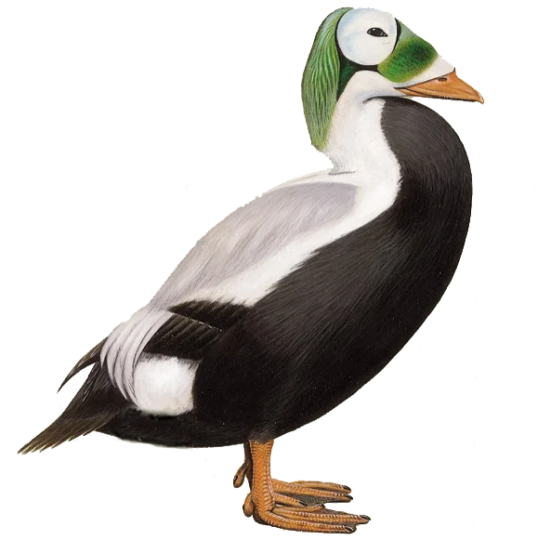
Measurements of Male and Female Spectacled Eiders
Michael Pecha

Slide 2
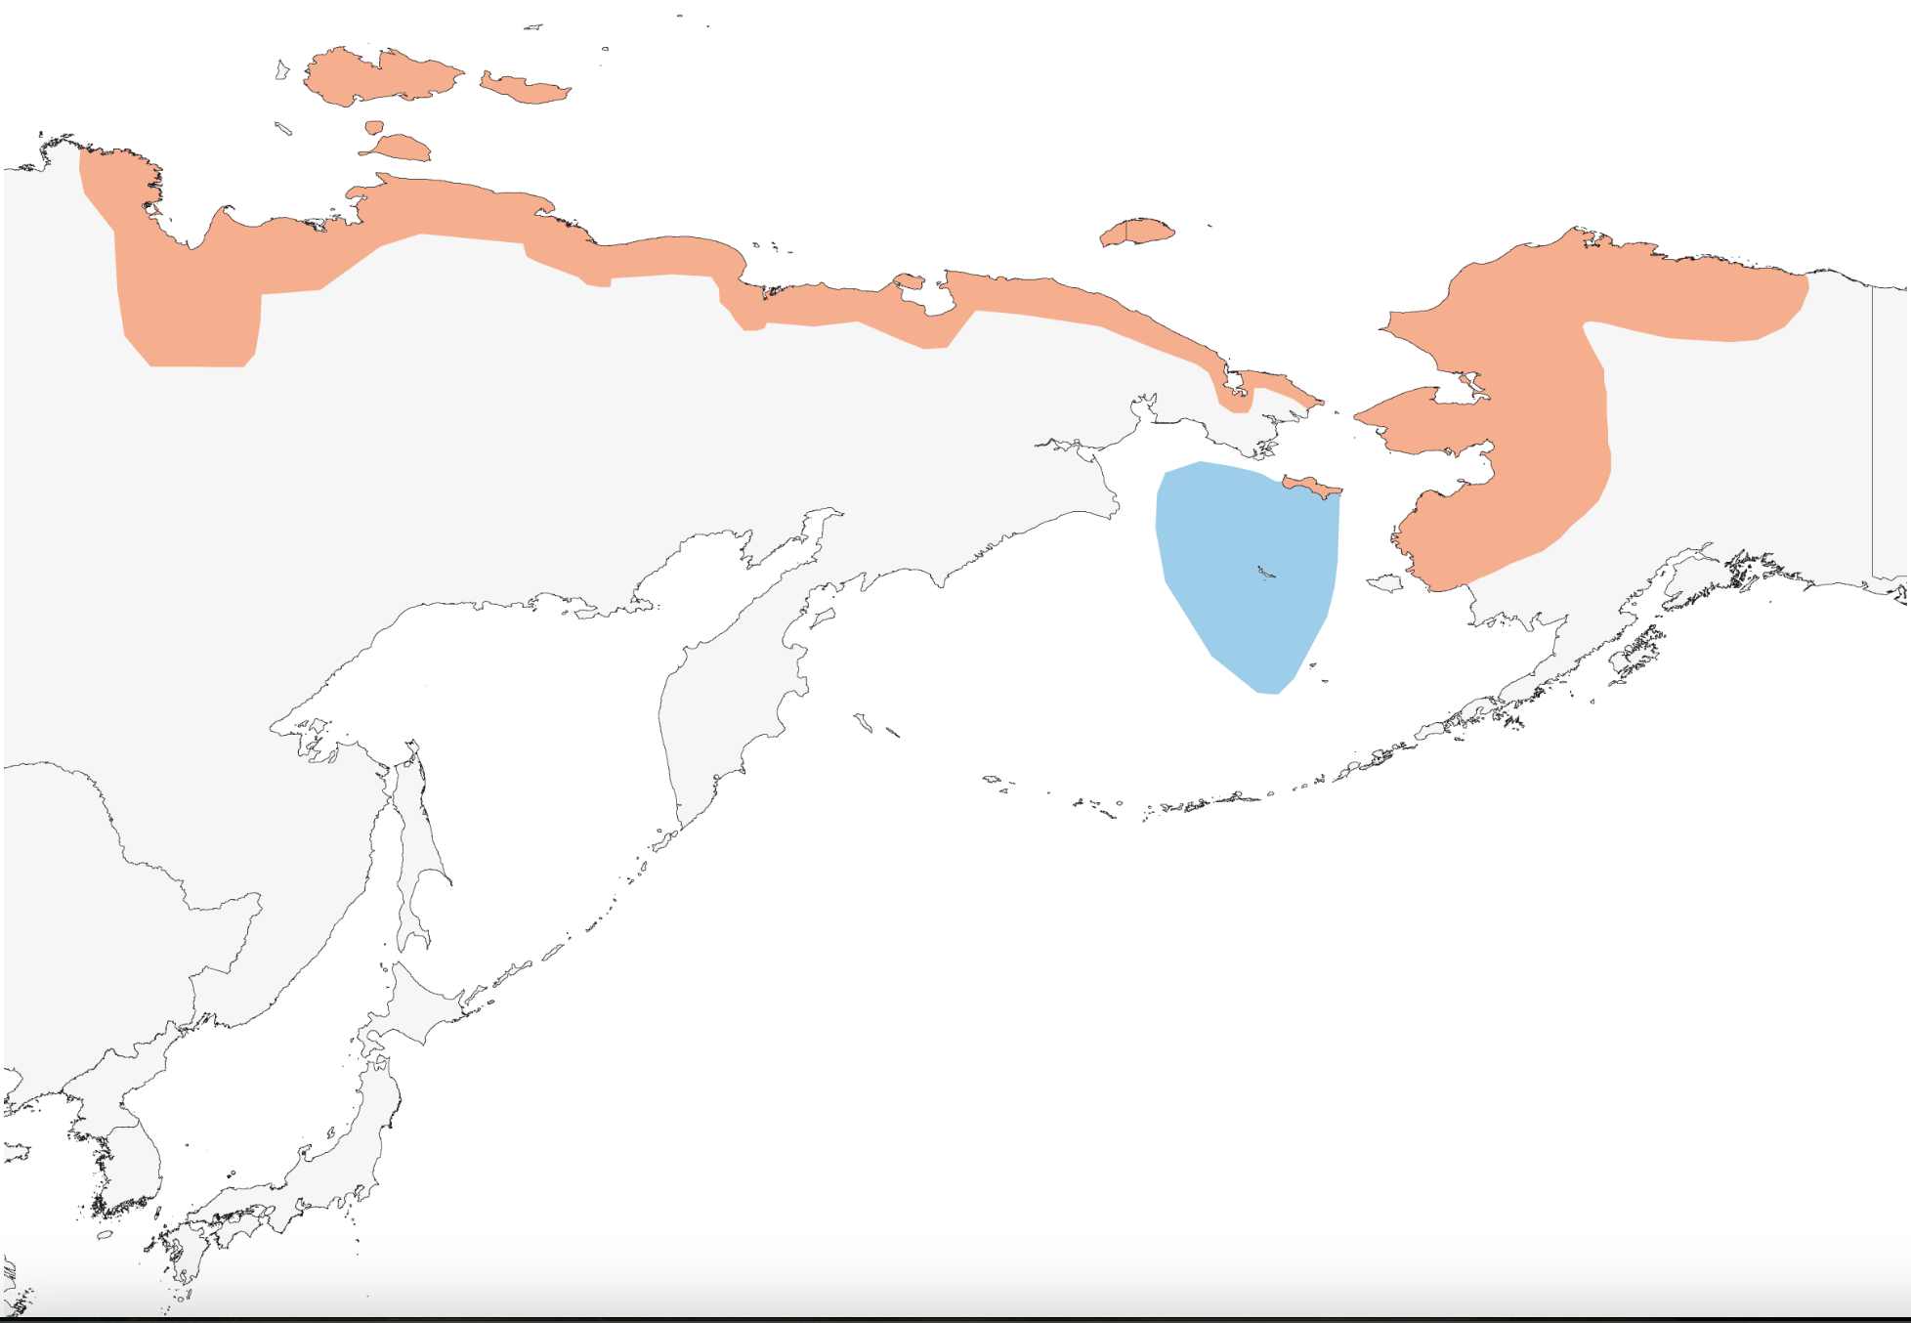
Background
Species: S. fischeri
Large sea duck
Resides in Alaska and Siberia
Near Threatened
Risks:
Climate Change
Habitat Loss
Population has been declining
: Non-Breeding
: Breeding

Slide 3
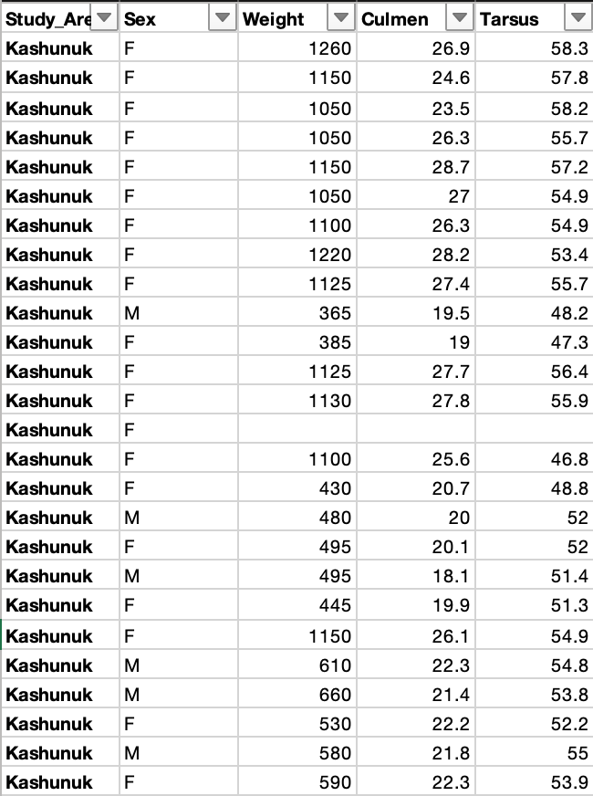
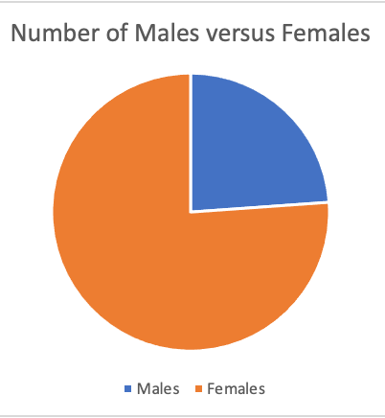
Data Set
Around 2500 individuals measured:
~ 1900 Female
~ 600 Male
Measured:
Weight
Culmen Length
Tarsus Length
Region: Kashunuk River and Kigigak Island in Alaska
Helpful to:
Determine health of population
Biodiversity

Slide 4


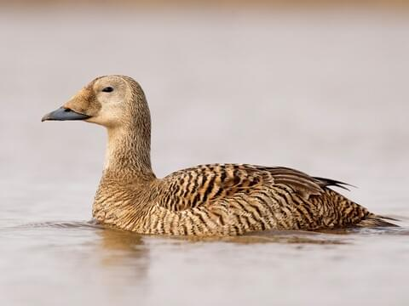
Anatomy
Culmen
Male Speckled Eider
Tarsus
Female Speckled Eider

Slide 5
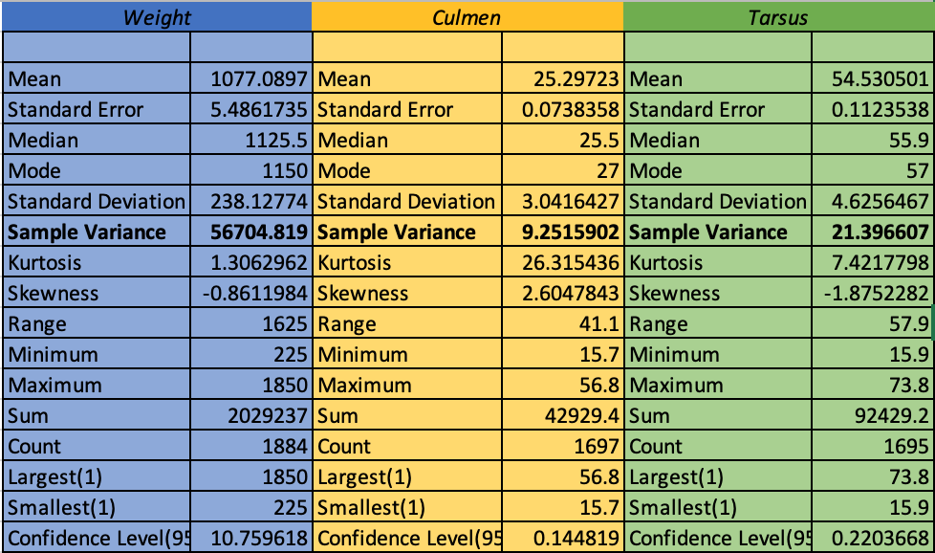
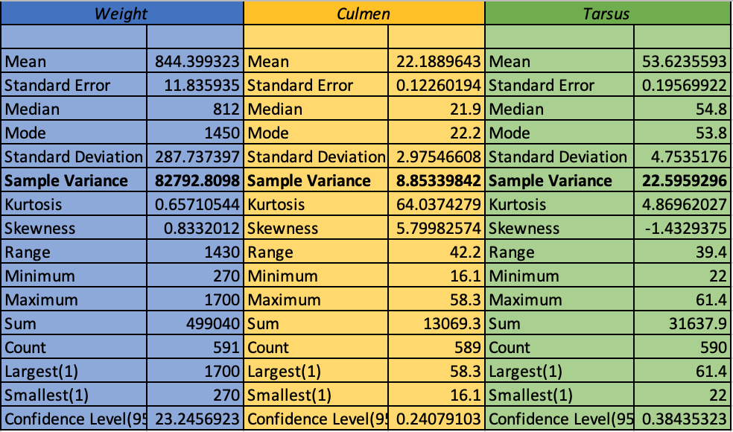
Descriptive Statistics
Females:
Males:

Slide 6
Hypothesis:
Null Hypothesis: There is not a significant difference between the (1) weight, (2) length of the culmen, and (3) length of the tarsus between male and female eiders.
Alternative Hypothesis: There is a significant difference between the (1) weight, (2) length of the culmen, and (3) length of the tarsus between male and female eiders.

Slide 7
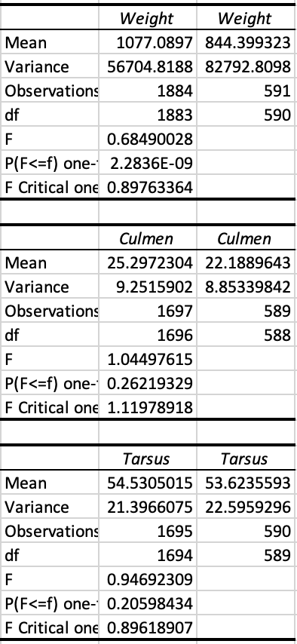
Equal or Unequal Variance?
Null Hypothesis: They do have equal variances
Alternative Hypothesis: They do not have equal variances
Apply F-Test: If F_{Value} > F_{Crit}, reject Null Hypothesis
Weight: 0.898 >0.685, reject null → Unequal Variance
Culmen: 1.120 > 1.045, reject null → Unequal Variance
Tarsus: 0.896 < 0.947, fail to reject null → Equal Variance

Slide 8
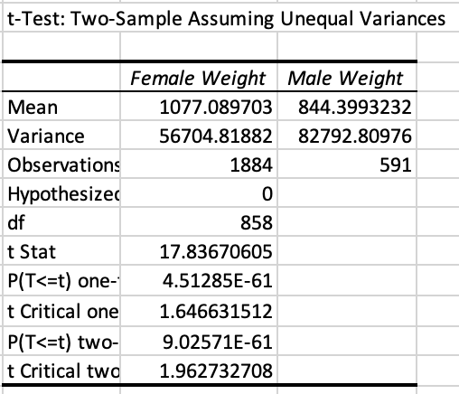
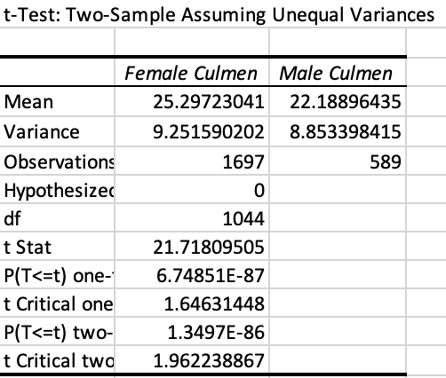
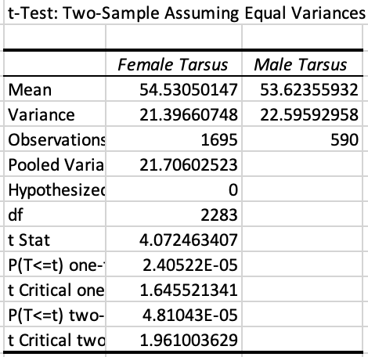
Test Chosen: T-Test
If T_{Stat} > T_{Crit}, reject Null Hypothesis
Weight:
Culmen:
Tarsus:
Conclusion: Reject the Null Hypothesis for all three measurements.
There is a significant difference between the weight, length of culmen, and length of tarsus between female and male eiders
17.837 > 1.963, reject null
21.718 > 1.962, reject null
4.072 > 1.961, reject null

Slide 9
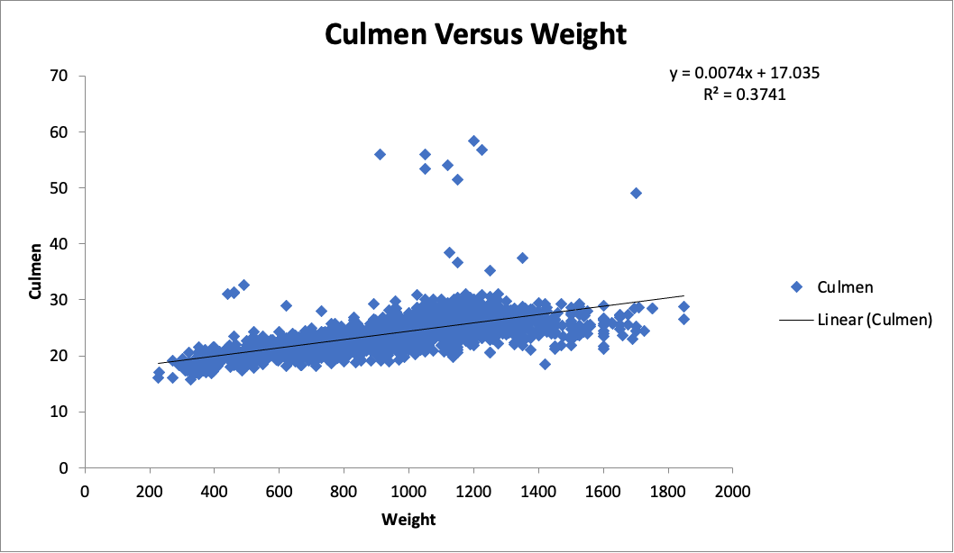
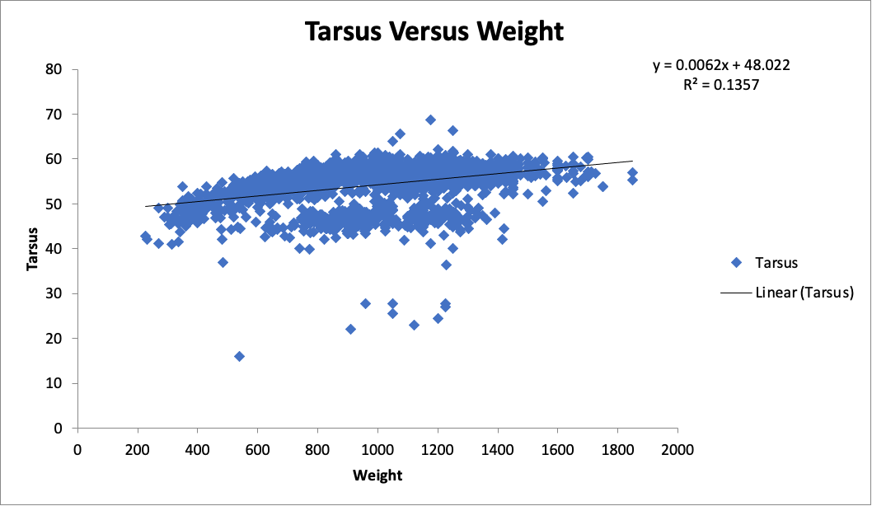
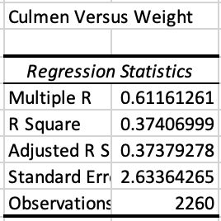
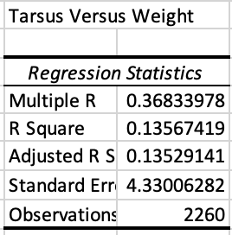
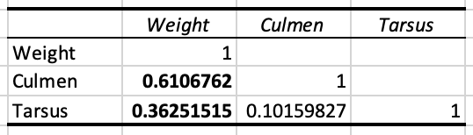
Does Weight Impact the Length of the Culmen and Tarsus?
Correlation:

Slide 10
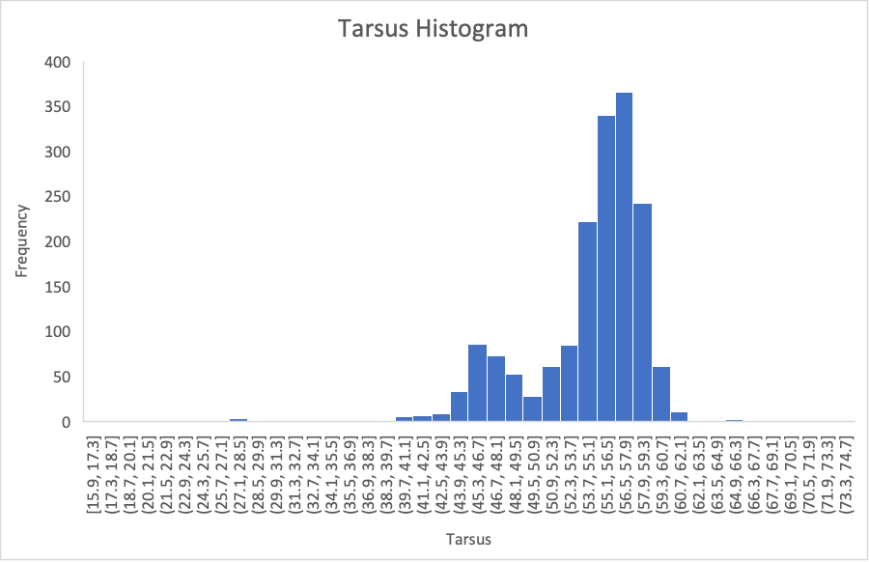
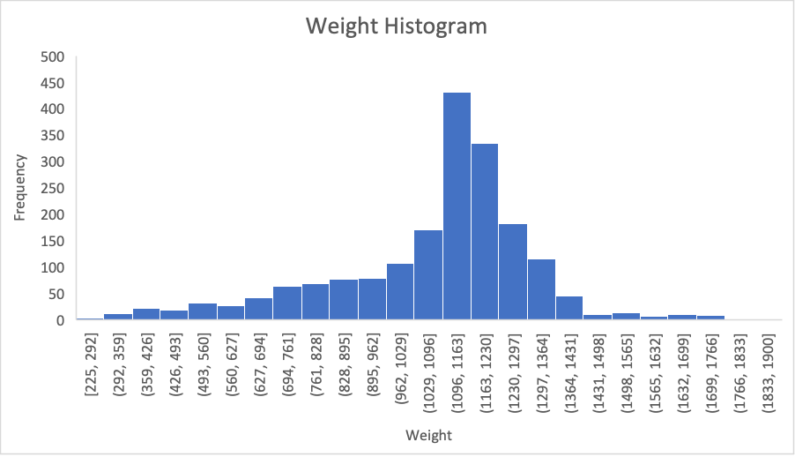
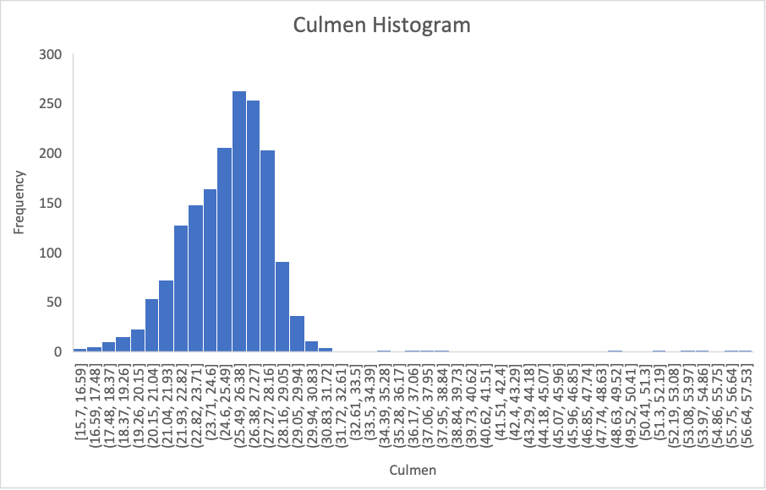
Female Histograms

Slide 11
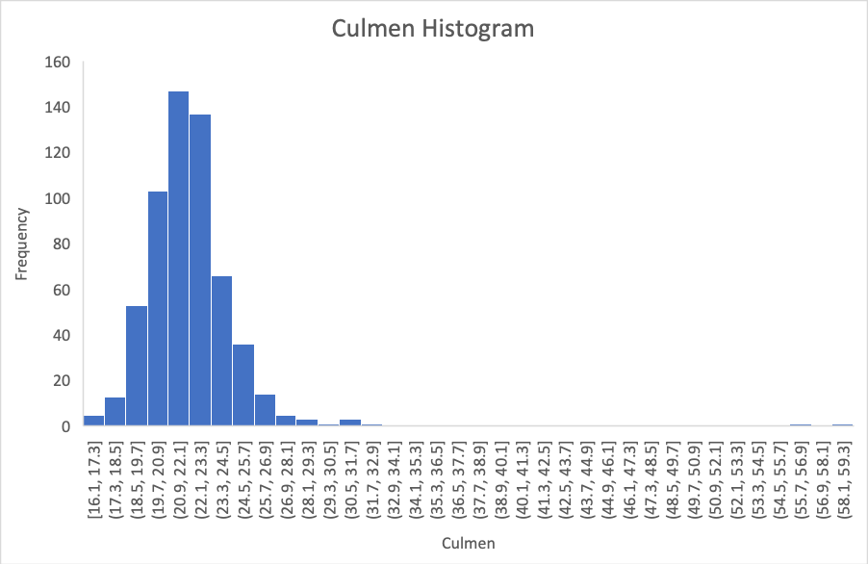
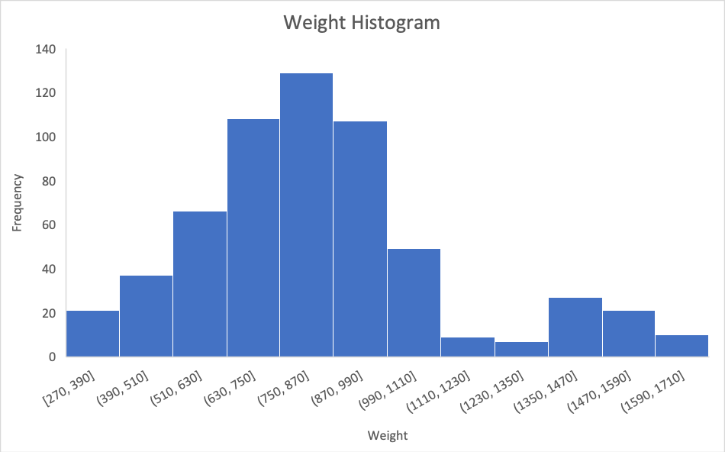
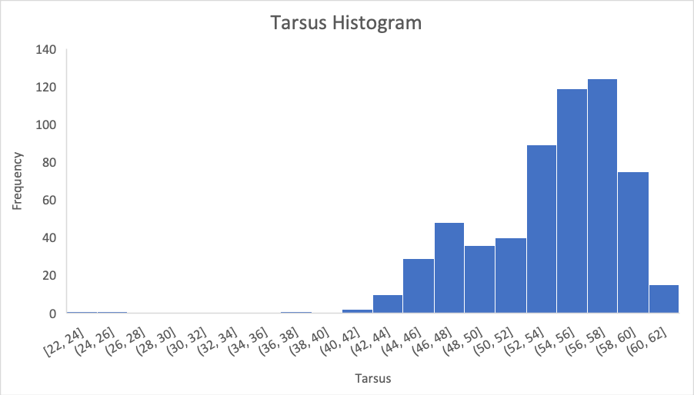
Male Histograms

Slide 12
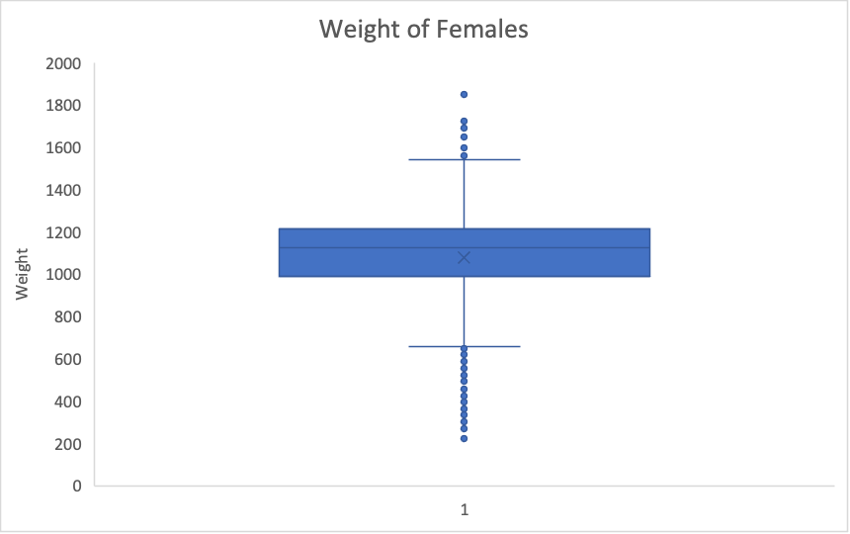
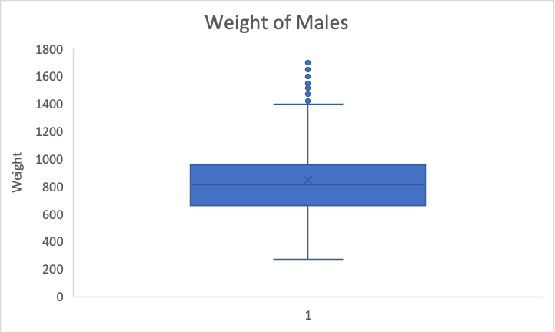
Box Plots of Weight Between Male and Female

Slide 13
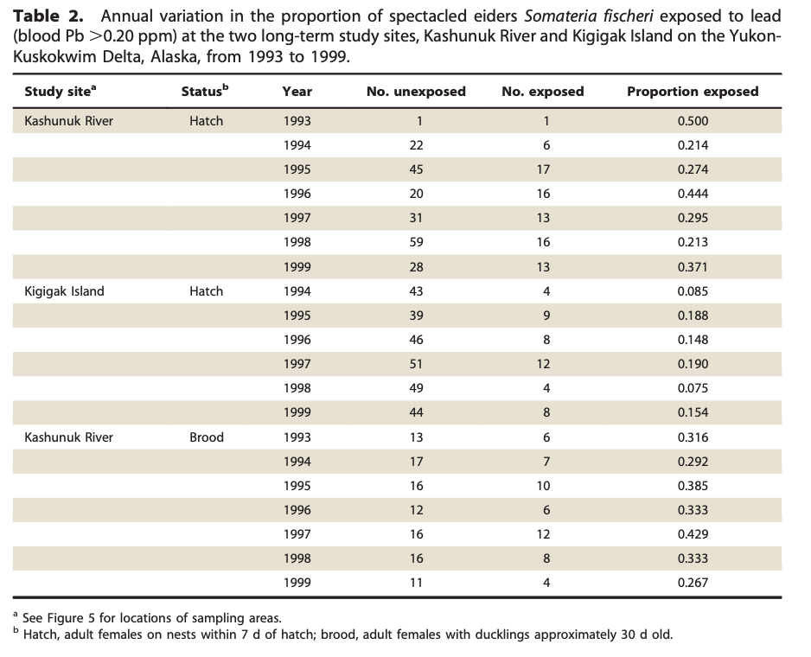
Other Published Works
Effects of Lead Exposure, Environmental Conditions, and Metapopulation Processes on Population Dynamics of Spectacled Eiders

Slide 14
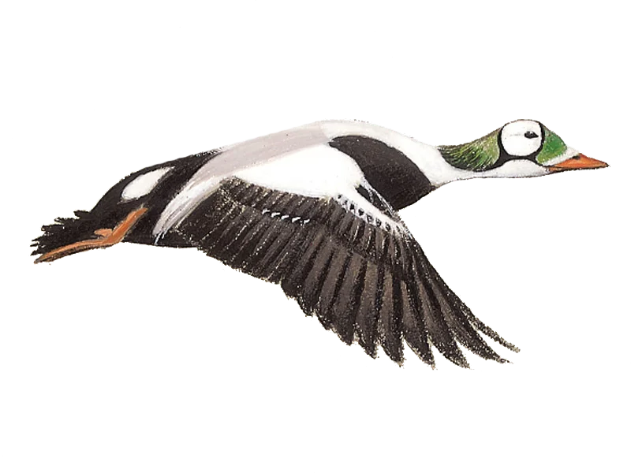
Conclusion
For this sample, male and female Spectacled Eiders differ in:
Weight
Culmen
Tarsus
Next Steps:
Need more male specimens
Consider age
Determine if population is still declining

Slide 15
References
Flint, P.L., 2016, Spectacled Eider (Somateria fischeri) nest, capture, and resight records Yukon-Kuskokwim Delta, Alaska (ver. 2.0, May 2023): U.S. Geological Survey data release, https://doi.org/10.5066/F74B2ZCK.
Flint P.L., Grand JB, Petersen MR, Rockwell RF. Effects of lead exposure, environmental conditions, and metapopulation processes on population dynamics of spectacled eiders. North American Fauna 81:1–41. doi:10.3996/ nafa.81.0001.

